Slide 1
Analyzing Cause & Effect

Slide 2
Rules to Follow for Cause and Effect
A CAUSE
Helps us think about why something happened
must come before an effect
AN EFFECT
Helps us consider what might happen later
must be the result of the cause
KEYWORDS
Benefits, downsides, results, causes, effects, created by….
Cause and Effect topic keywords will show a relationship through space or time
Example: The roof may have collapsed because of the heavy snowfall last night, but it is just as likely that faulty building techniques when the building was constructed are really to blame.
YOUR TOPIC MUST GO BEYOND OBVIOUS OR ALREADY PROVEN IDEAS

Slide 3
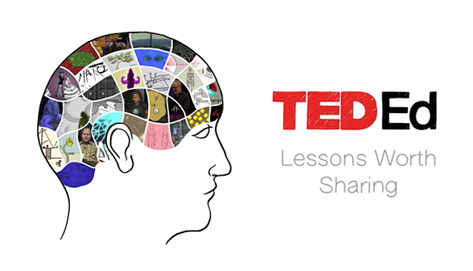
Let’s watch an example →
Identify whether this TED Talk is discussing causes or effects. What is their “thesis statement?” What are the causes or effects they discussed?

Slide 4
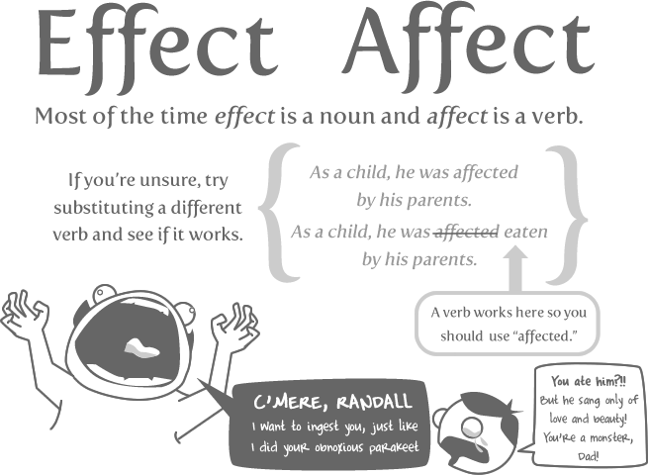
Let’s get some grammar out of the way real quick…
Causal =/= Casual
Ways to perfect Affect vs. Effect
RAVEN
Remember, Affect is a Verb, Effect is a Noun
The Oatmeal -->
Socratia (video)

Slide 5
Types of Causes and Effects
Usually you will encounter several possible causes or effects. How do you keep track of what’s important?
EXAMPLE: Why are people afraid of the dark?
Create a list at your tables
Sort these causes into different types
Immediate Causes: those situations that happen either very near in space to the cause or very close in time (Tim gets a sunburn because he’s been outside all day)
Remote Causes: situations that happen a long time before the effect, very far away from the effect, or are in any other way, less obvious (Time gets a sunburn because he has a melanin deficiency, despite coming from a naturally tan family).
These definitions are the same for types of effects

Slide 6
Structure
Generally you focus on either causes or effects
Cause → leads to → Effects 1, 2, and 3 (A focus on effects)
Deforestation of the rainforest results in less species diversity, higher supply for “exotic” imports, and an easier legal process for harming other natural environments.
Effect → is the result of → Causes 1, 2, and 3 (a focus on causes)
Deforestation of the rainforest happened as a result of unmet demands for farmland, protected lands in the US pushing loggers to other countries, and lax international law.
But you can also trace a history of causes and effects, called a causal chain
Cause 1 → leads to → Effect 1 → is the cause of → Effect 2 → is the cause of….
Why pirating music is so rampant and unchecked (this is asking for causes)
Digital music hit the market in 2001 → record companies, instead of embracing the idea, tightened restrictions on digital ownership → napster made it easy to digitally transfer music to one another for free→ record sales fell → record companies opened lawsuits against individuals and torrent servers → digital copyright laws had to be re-examined → because the laws on digital ownership and sharing are still vague, and because people have become accustomed to digital downloads, pirating rarely feels like a crime to US citizens.
These are not different causes, but all linked in time to create a chain reaction
Another example → Video

Slide 7
Causal Chains
When an effect becomes the cause for a future effect, creating a chain reaction

Slide 8
Things get messy
Don’t bite off more than you can chew! Vox “Syria’s War: Who is Fighting and Why” Video here →

Slide 9
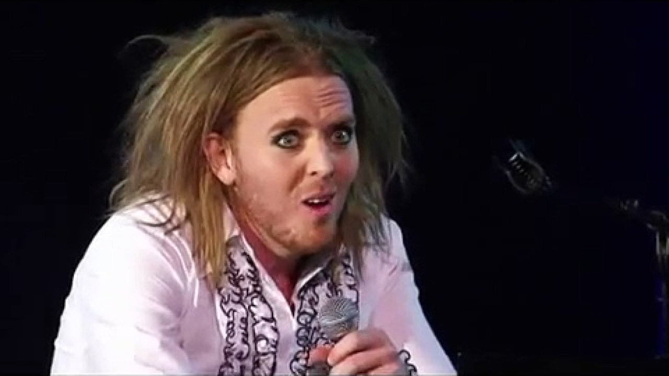
A Fallacy to avoid
Post-hoc reasoning: or logic that suggests that just because something comes AFTER something, it is the RESULT of something. This is not always true.
Tim Minchin “On Human Logic”

Slide 10
Try it out for yourself. Jumpstart to exercise #8:
What books have you chosen? What are there genres? Why do people read this genre?

